Slide 1
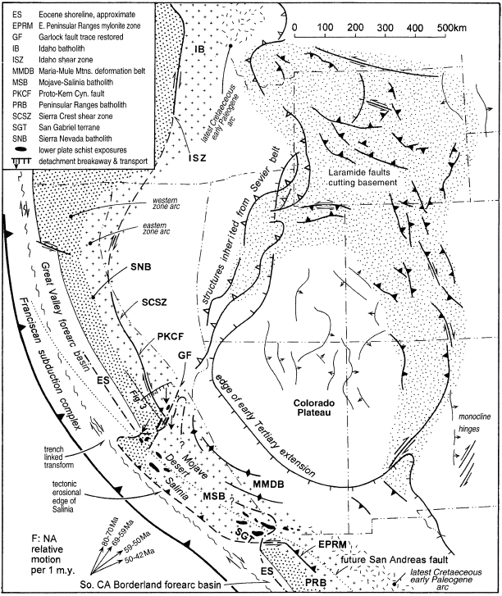
Segmentation of the Laramide Slab – evidence from southern sierra Nevada region
Saleeby 2003
Geol 730 Presentation By: Neal Mankins
Figure 1
End of the Laramide Orogeny reconstruction ~60Ma

Slide 2
Purpose
Questions
To examine petrologic and geochemical data on lower crust – upper mantle xenoliths and their implications on geologic features attributed to the Laramide orogeny
The Basics
When did the Laramide orogeny begin?
Why did it begin?
When did it end?
Why did it end?
What are the geologic features associated with these events?
Method
Using previously gathered petrologic & geochemical data
Reconstructing/ restoring principle tectonic elements of the Laramide orogeny
Creating cross sections to visualize reconstructions based on previous data

Slide 3
Background
Laramide Orogeny
Late Cretaceous – Early Paleogene (85-60Ma)
Deformation along a N-NE corridor from SW Arizona to Wyoming (for the most part in-board of the Sevier fold & thrust belt)
Deformation associated with flat slab subduction
Result
End of arc magmatism in the Sierra Nevada Batholith (SNB)
Metamorphic underplating
Spatially related deformation along a ~500km segment of the cordilleran batholith
Note: Plate motion vectors with time

Slide 4
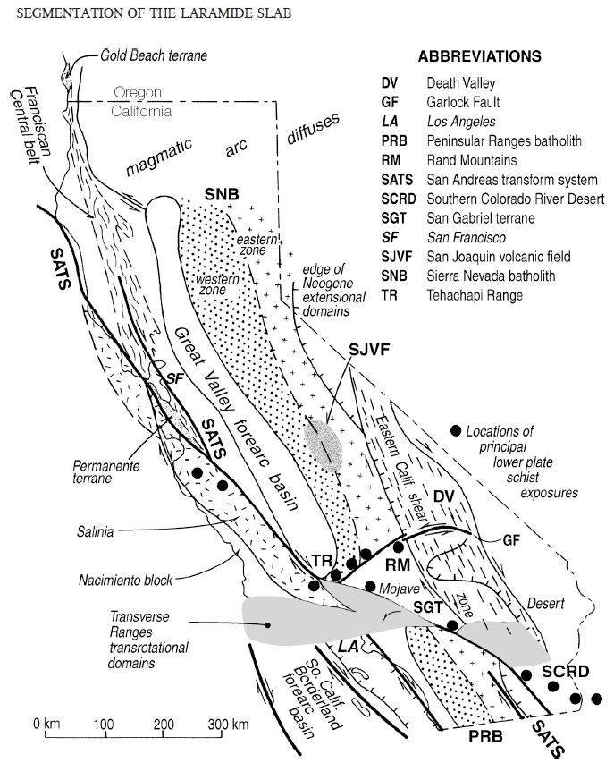
Restorations
Salinia & San Gabriel terrane along San Andreas
Transrotational deformation of transverse ranges
Garlock Fault displacement
Death Valley transtensional strain
Data
Petrologic and geochemical data on lower crust upper mantle xenoliths from the San Joaquin volcanic field (SJVF)

Slide 5
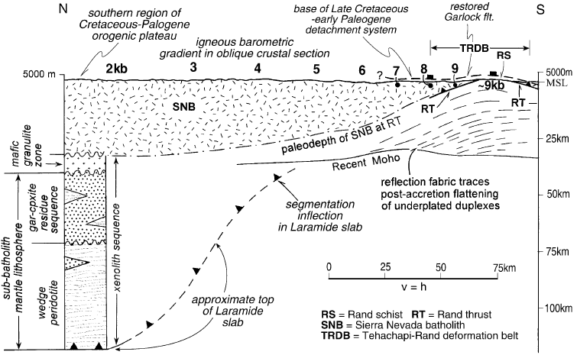
Cross Section of the Sierra Nevada Batholith (SNB)
Southern ~100km “exposes a southward deepening oblique crustal section through batholith crust from ~7-35km”
The southern most Sierra region “Tehachapi seismic structures” correlates with northern Mojave “Rand Mtn. seismic structures”
(also correlate in age, lithology, & isotopically)
Results
Seismic and xenolith data offer depth picture of SNB
Base of batholith & underlying mantle lithosphere have been tectonically removed
Rand schist is a result of Franciscan protoliths accreted and underplated resulting in bending of the deep batholithic rocks resulting in the westward protruding “tail” of the south SNB
(Pre-Miocene Cross Section)

Slide 6
Response to Shallow Slab Segment
Distribution of the Rand & related lower plate schists
Structure of the southern SNB “tail” & overlying Mojave-Salinia batholith (MSB)
Initiation of schist underplating
End of batholithic magmatism in the SNB caused by the disruption of the asthenosphere flow pattern
This shallow slab segment is defined by the “termination of magmatism, deformation, and rapid denudation of overlying rocks”

Slide 7
Oblique Flat Slab Subduction
“This abnormal subduction geometry of flat slab segments are thought to arise from buoyancy effects of thickened crustal sections relative to that of the deep lithosphere”
Comparable to the aseismic Juan Fernandez ridge descending beneath the Andes
Partitioning of dextral shear into the southern SNB seen in the “proto-Kern Canyon fault” where it exhibits westward reverse components that increase south into the Rand thrust system
Garlock fault used as a surface tracer for relative plate motion between Farallon and North American plates
Contrast between deformation expressions between SNB-MSB (dextral) & MSB-PRB (sinistral) reflect the obliquity of slab subduction

Slide 8
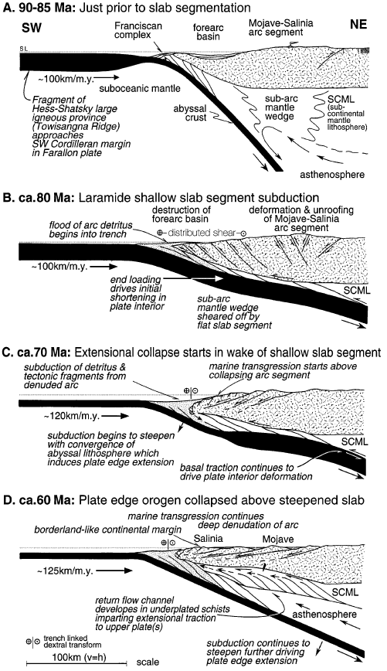
Time Space Model
Uplift & Collapse of the Mojave-Salinia Batholith
1. Subduction of the Towisangna ridge (Franciscan complex) similar to the Hess-Shatsky igneous province ~80Ma (similar to the subduction of the Nazca Ridge in South America)
Southernmost Sierra the mantle lithosphere was sheared off & displaced deeper into the mantle terminating mantle wedge driven arc magmatism to the SNB
This thickened mafic crustal section rendered greater buoyancy leading to flat subduction
2. Underplated schist protoliths led to high water flux migration promoting weakening of the upper plate
Crustal thickening, and isostatic uplift from underplating led to a weakened orogenic crustal section highly susceptible to gravitational collapse
3. Passing of the Towisangna Ridges trailing flank beneath the plate edge attended steepening of the slab
This steepening induced suction along the slab upper plate inducing regional extension and subsidence

Slide 9
Findings
Flat Slab Subduction
The Laramide Orogeny arose from subducting a counterpart of the Hess-Shatsky igneous province of the NW pacific basin
The subducting Laramide slab was shallow to the South and deeper to the north
In the southernmost Sierra the mantle lithosphere was sheared off by a shallow segment of the Farallon slab & displaced deeper into the mantle
The shallow slab segment appears to have been ~500km wide based on distribution of lower plate schists

Slide 10
Take Home Points
What initiated flat slab subduction? & when?
Subduction of the Towisangna ridge (Franciscan complex) similar to the Hess-Shatsky igneous province ~80Ma
The subarc mantle wedge and part of the subcontinental mantle lithosphere are sheared off and displaced down dip into the mantle, terminating wedge driven arc magmatism (stopping formation of SNB
It was ~500km wide
What ended flat slab subduction? & when?
Passing of the Towisangna Ridges trailing flank beneath the plate edge attended steepening of the slab ~70ma

